Slide 1



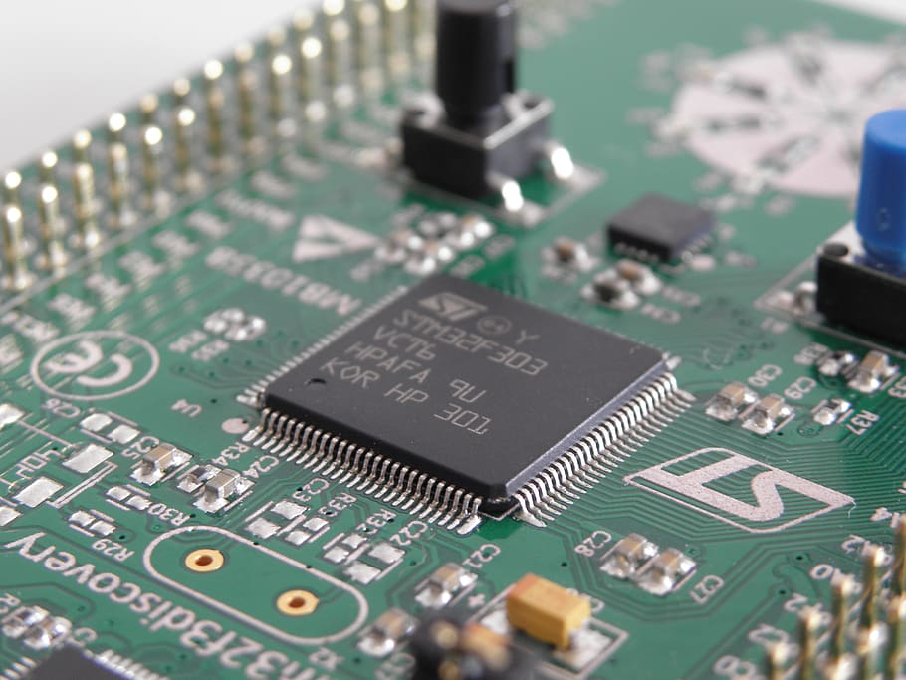


INFRAMOTE
Android Aplication for Controlling IR Controlled Devices
DCC Project Group 6

Slide 2
<slide-name>
Supervised By
Submitted By
Mohammad Ariful Hyder
Professor
Department of CSE
Dhaka City College
Prince Billy Graham Karmoker Class Roll: 44
Reg: 1652000458
Ahesanul Karim Abid Class Roll: 38
Reg: 16502000521
Inframote by DCC Project Group 6
Slide <number> of 26

Slide 3
<slide-name>
Inframote by DCC Project Group 6
Slide <number> of 26

Slide 4
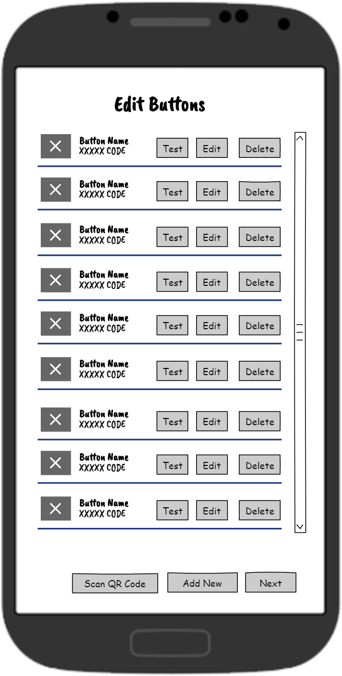

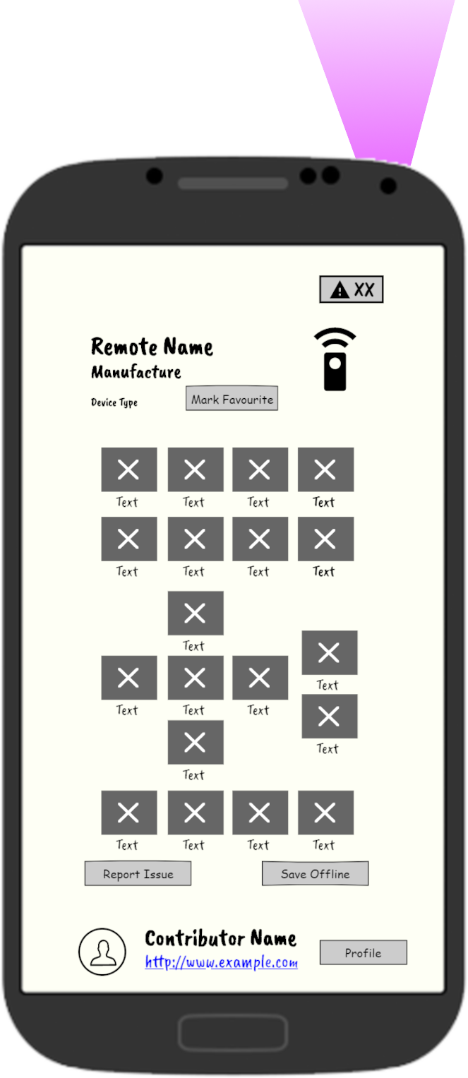
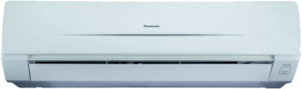
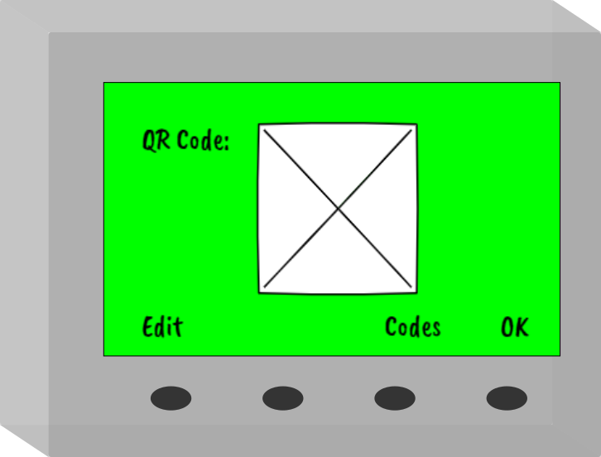
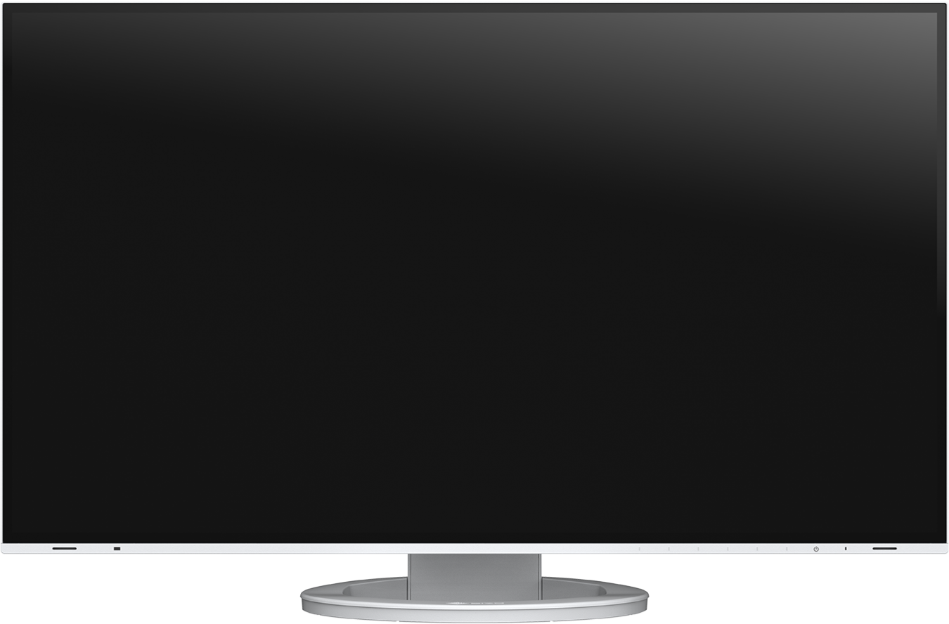
<slide-name>
InfraMote is an Android app that lets you use your phone as an all-in-one IR remote to control your TV, fan, light, air conditioner, or pretty much any other electrical item that requires an IR-based remote.
Inframote by DCC Project Group 6
Slide <number> of 26

Slide 5






<slide-name>
Play Store Rating under 4.3
Play Store Rating under 3.5
MI Remote
Rcoid Free
ZaZa Remote
Sure Remote
Lean Remote
Asmart IR
Inframote by DCC Project Group 6
Slide <number> of 26

Slide 6


<slide-name>
Features | MI Remote | Lean Remote | Others | Inframote
Allows Contribution
Custom Remote
External Reciver
Local Devices
Friendly UI
Inframote by DCC Project Group 6
Slide <number> of 26

Slide 7
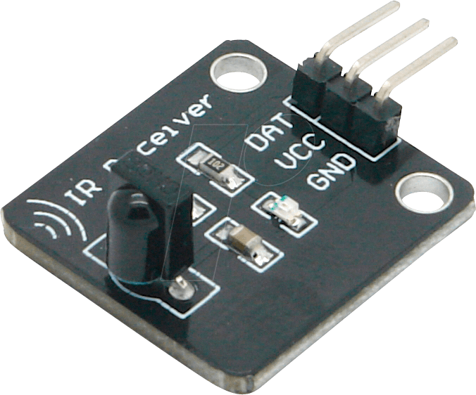


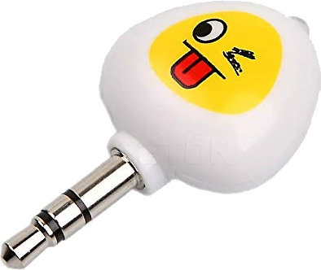


<slide-name>
Developing an IR remote Android app that addresses all of the issues listed below:
Has the capacity to record infrared (IR) signals
(supported in phone with IR receiver)
All local brands are supported
External IR Sender is supported
Allows you to construct
personalized remote
Inframote by DCC Project Group 6
Slide <number> of 26

Slide 8



<slide-name>
Premium users get an ad-free experience.
Remote contributors get an ad-free experience.
Other users are required to see Google Ads.
Inframote by DCC Project Group 6
Slide <number> of 26

Slide 9
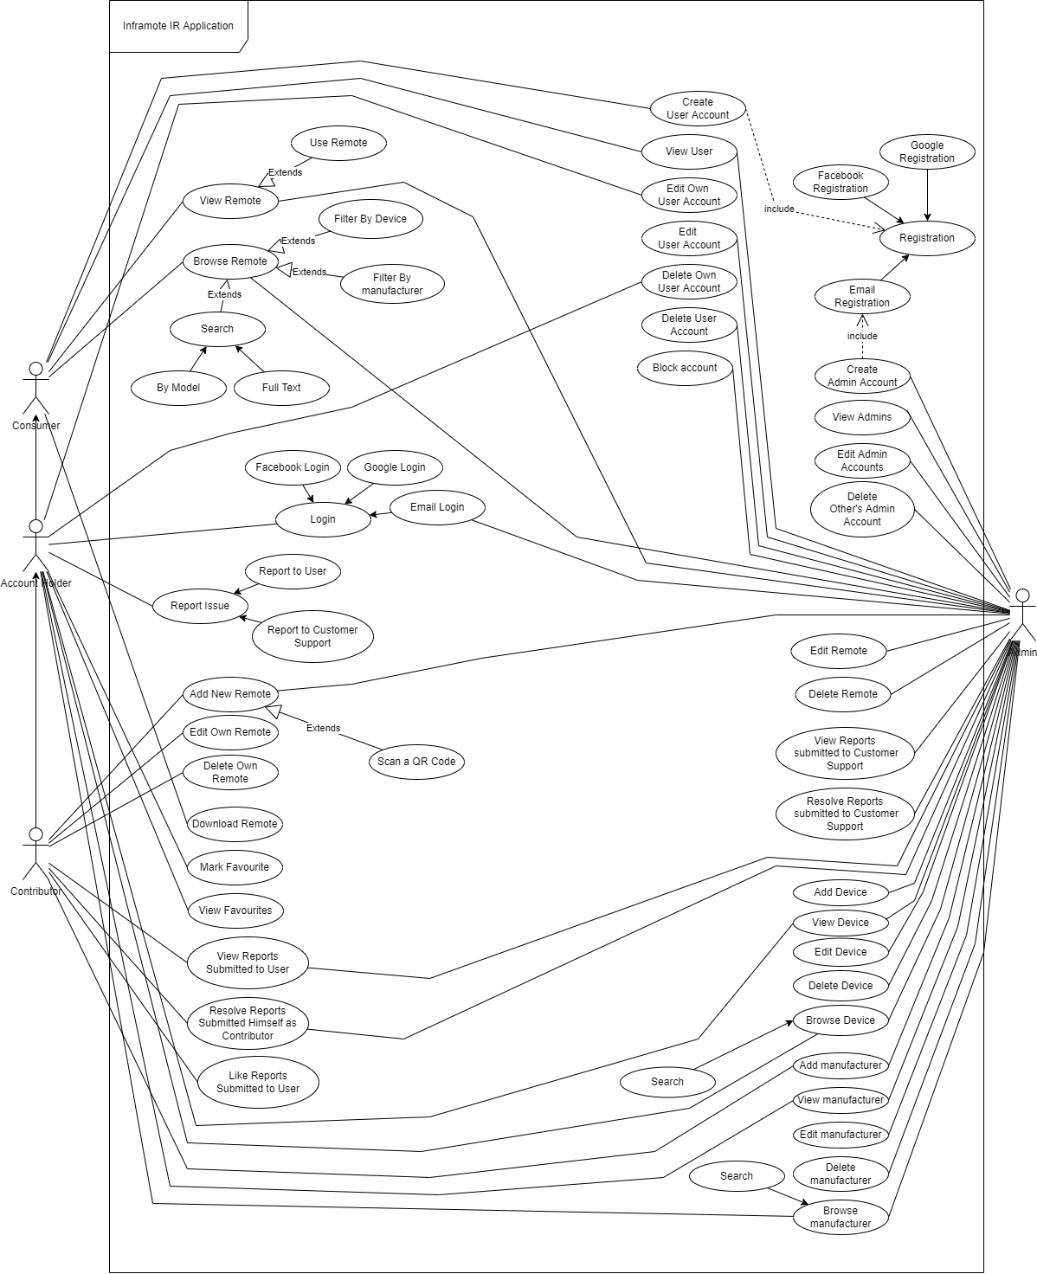
<slide-name>
Inframote by DCC Project Group 6
Slide <number> of 26

Slide 10
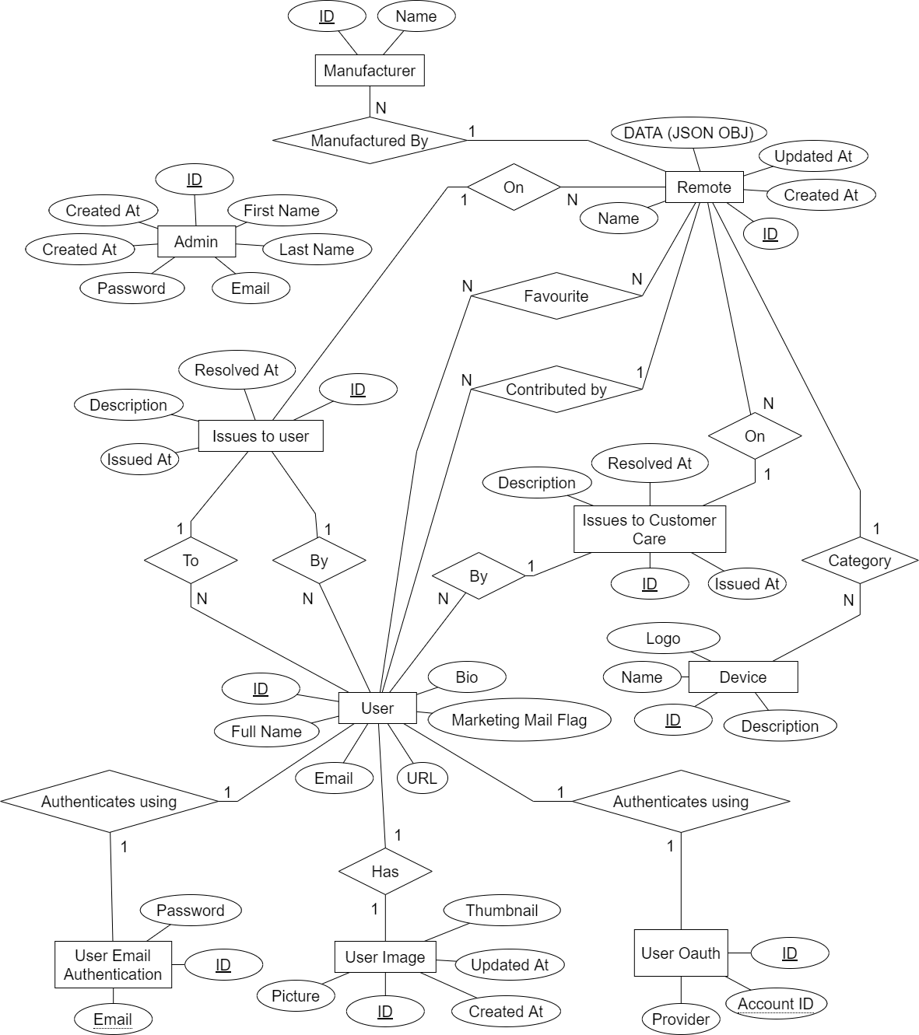
<slide-name>
Entity Relationship
Diagram
Inframote by DCC Project Group 6
Slide <number> of 26

Slide 11
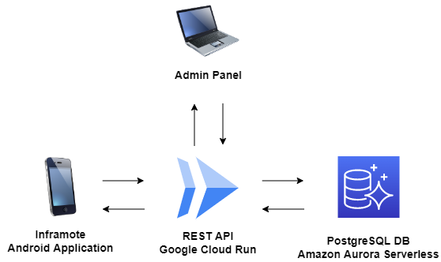
<slide-name>
Cloud Architecture Diagram (Production Server)
Inframote by DCC Project Group 6
Slide <number> of 26

Slide 12
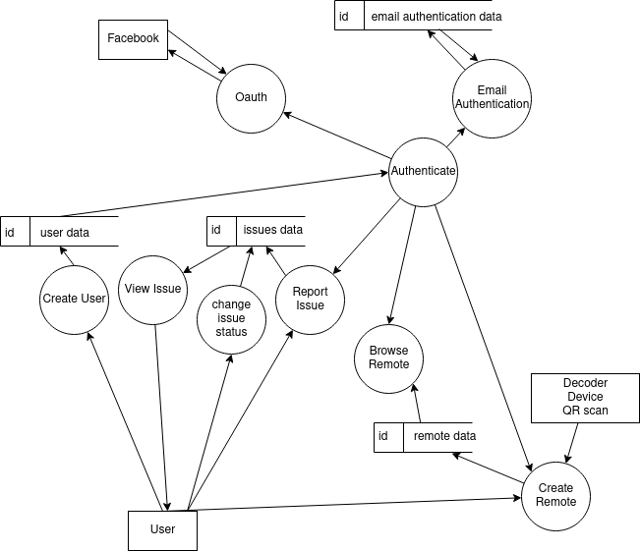
<slide-name>
Data flow Diagram
Inframote by DCC Project Group 6
Slide <number> of 26

Slide 13
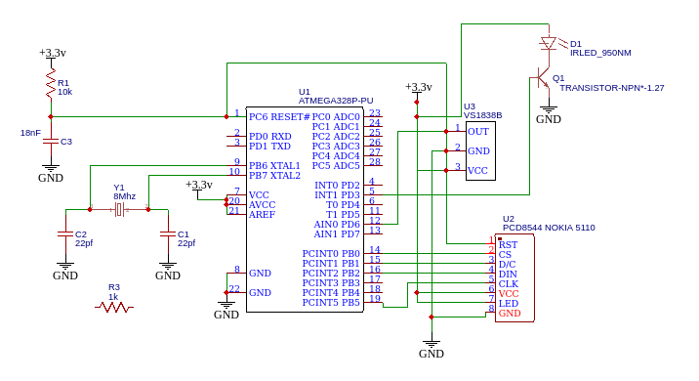
Prototype
Circuit Diagram
Inframote by DCC Project Group 6
Slide <number> of 26

Slide 14

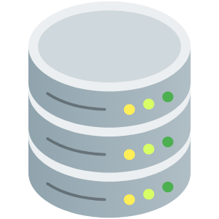




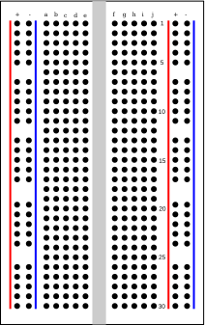
<slide-name>
Android
Application
RDBMS Schema
REST API
API Documentation
Hardware Prototype
Project Book
Presentation
Inframote by DCC Project Group 6
Slide <number> of 26

Slide 15
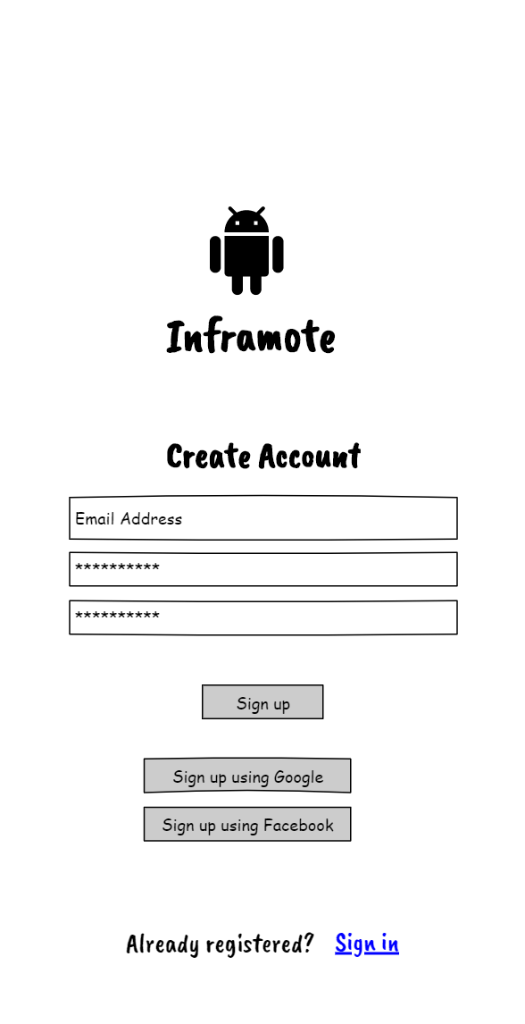
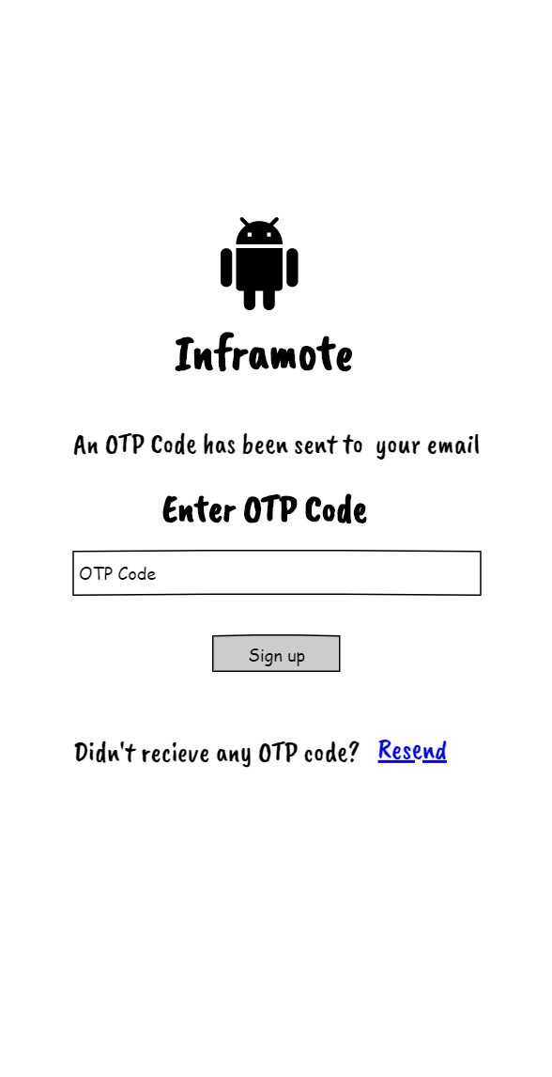
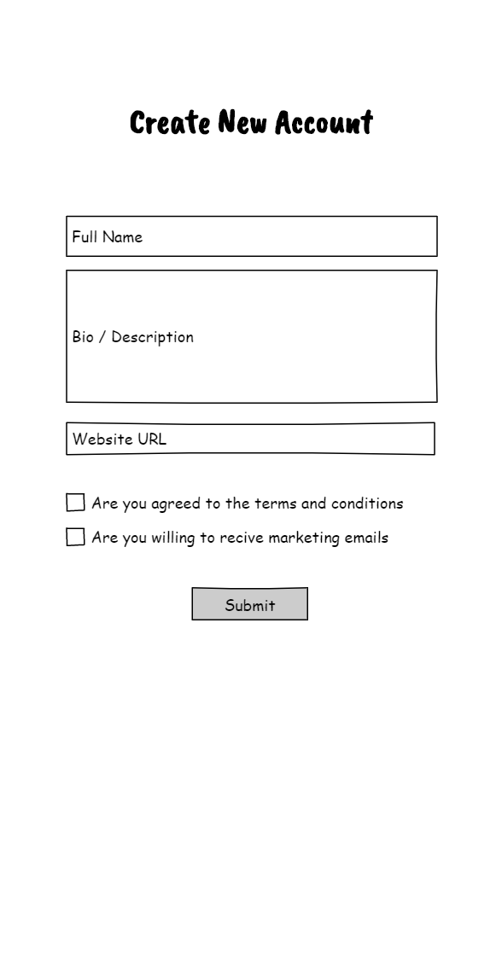
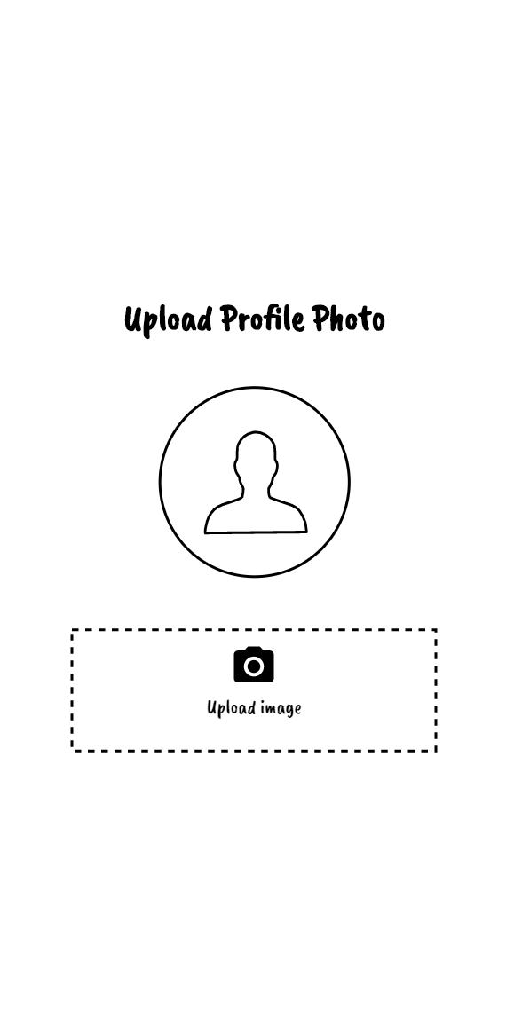
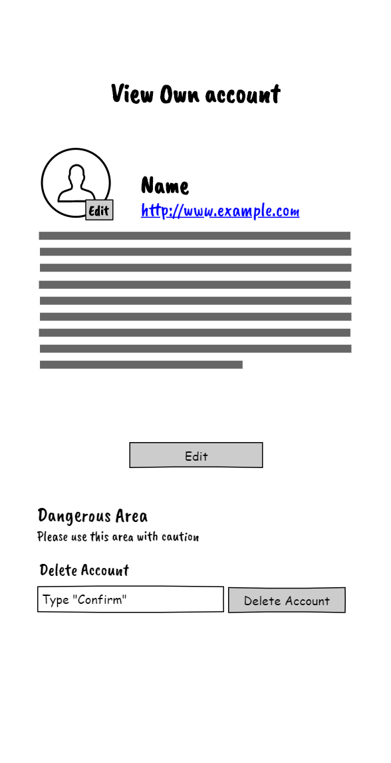
<slide-name>
Inframote by DCC Project Group 6
Slide <number> of 26

Slide 16
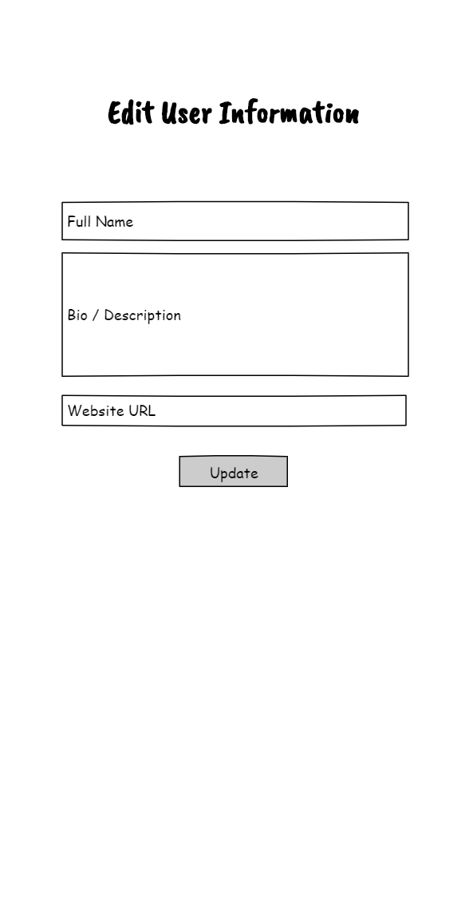

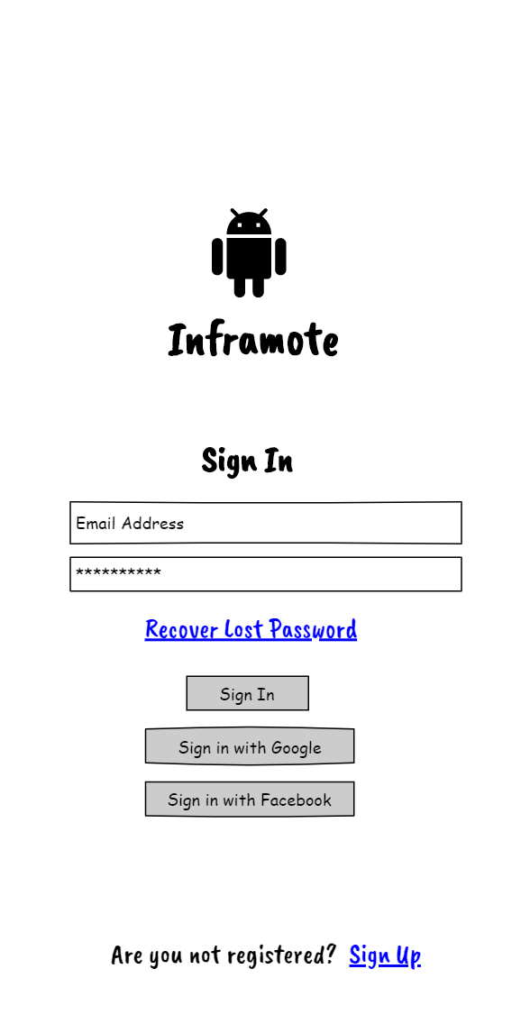
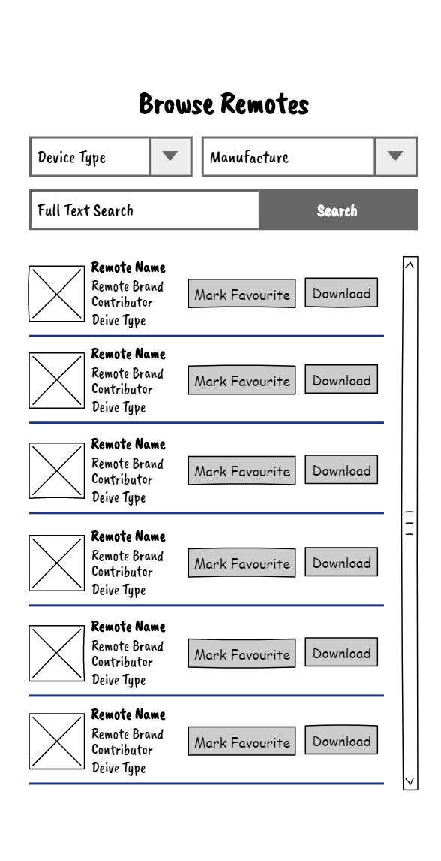
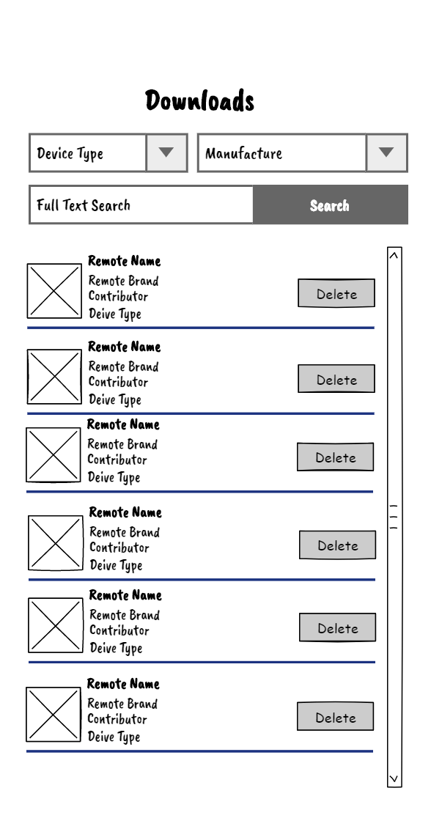
<slide-name>
Inframote by DCC Project Group 6
Slide <number> of 26

Slide 17
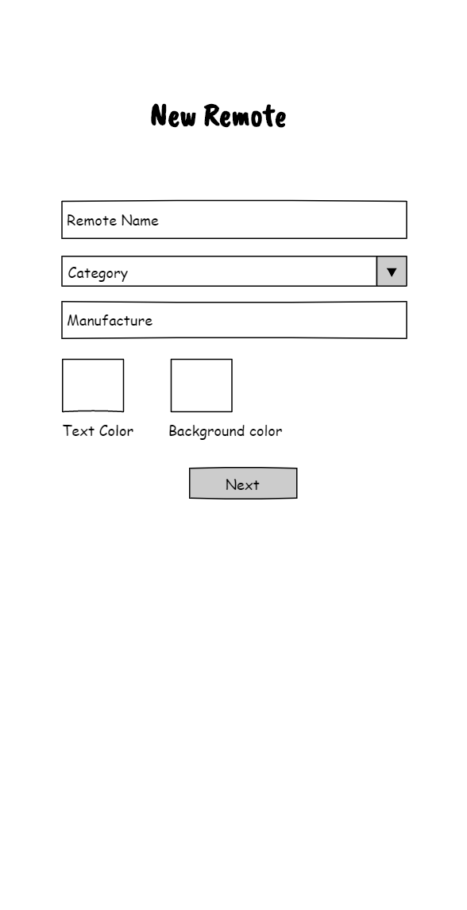
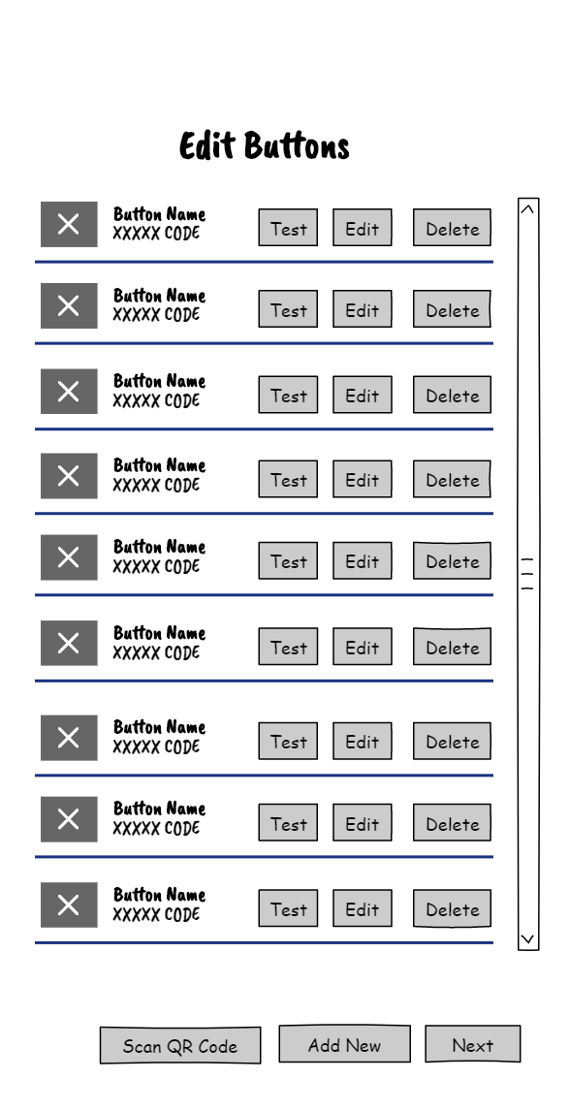
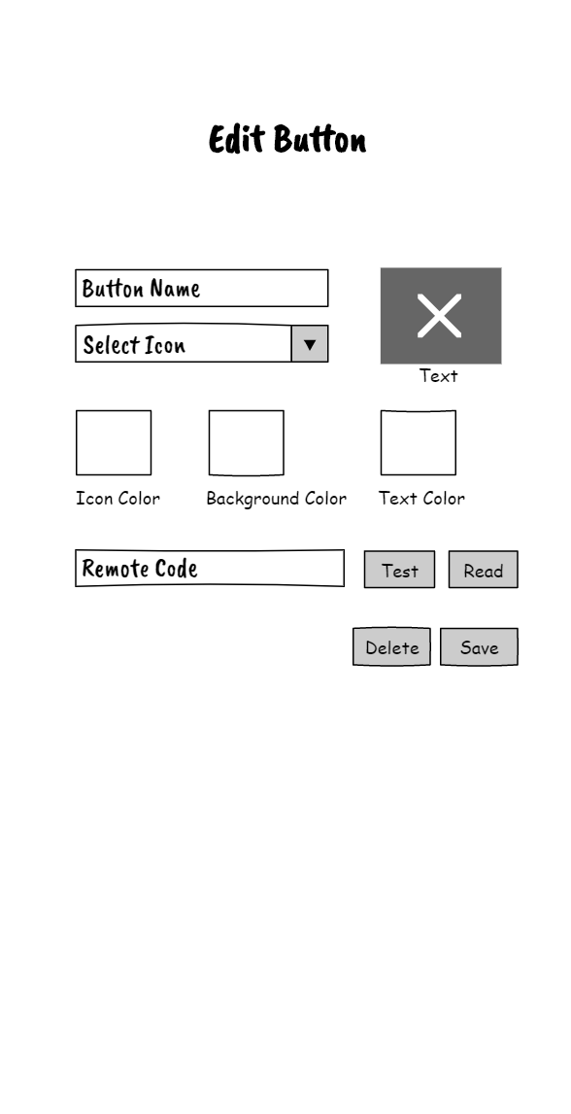
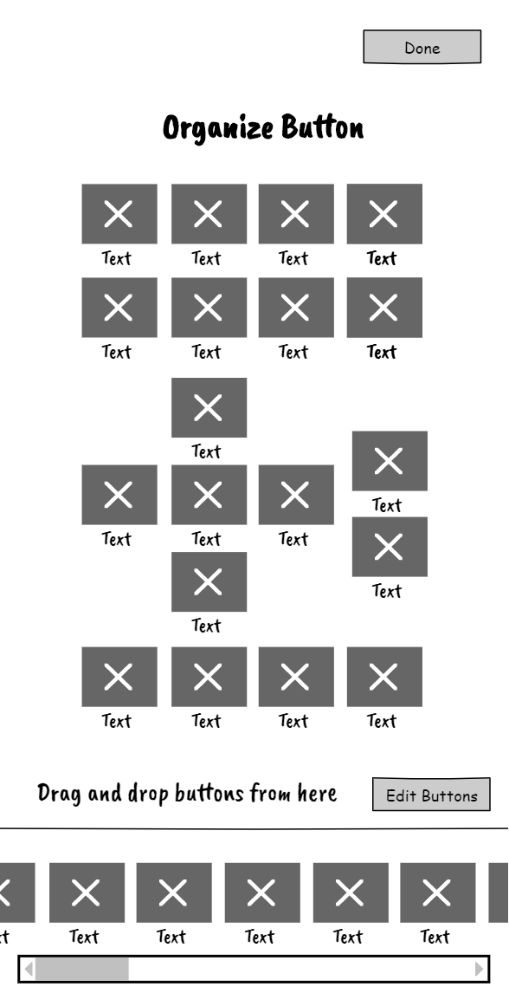
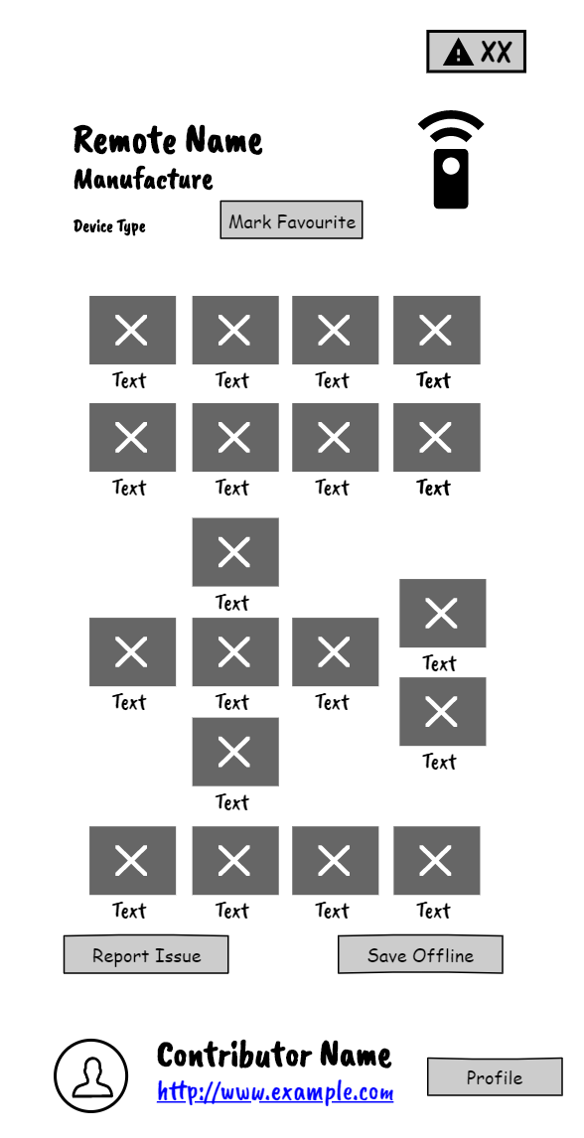
<slide-name>
Inframote by DCC Project Group 6
Slide <number> of 26

Slide 18
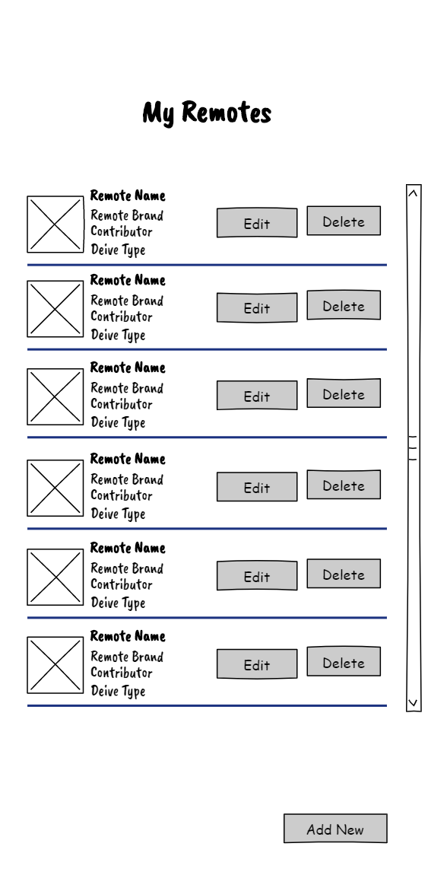
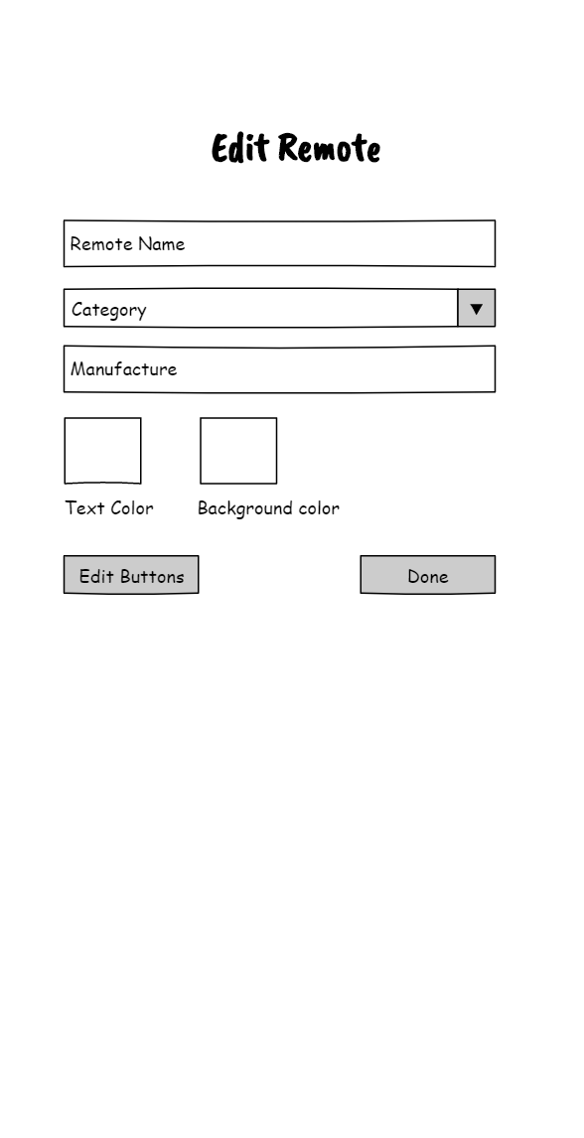
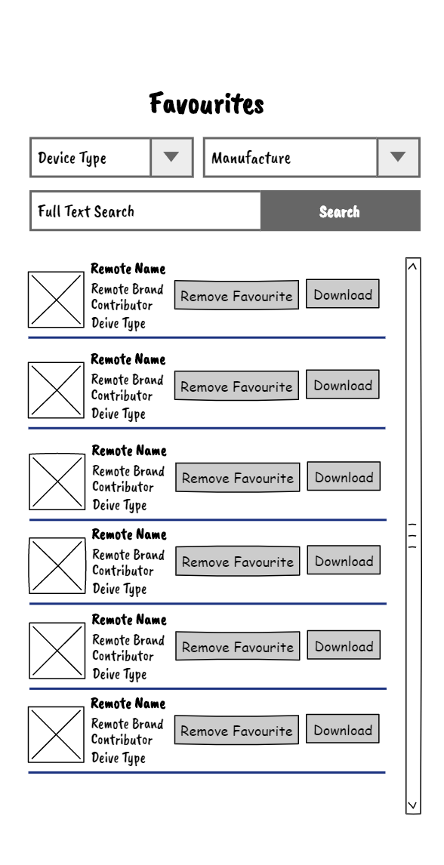
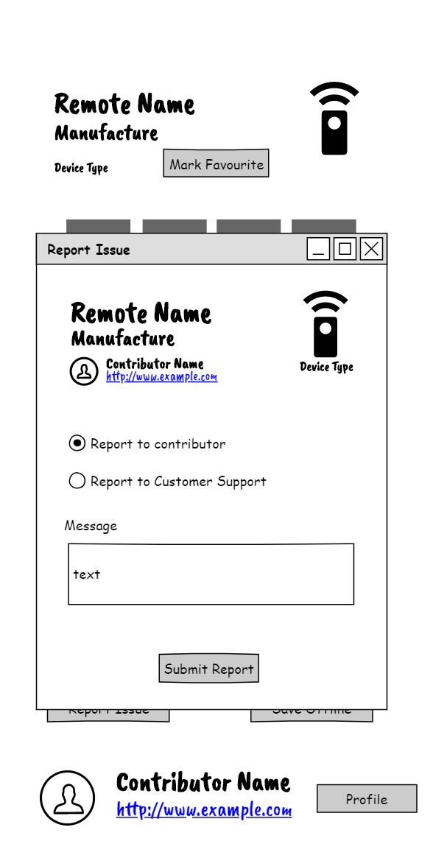
<slide-name>
Inframote by DCC Project Group 6
Slide <number> of 26

Slide 19
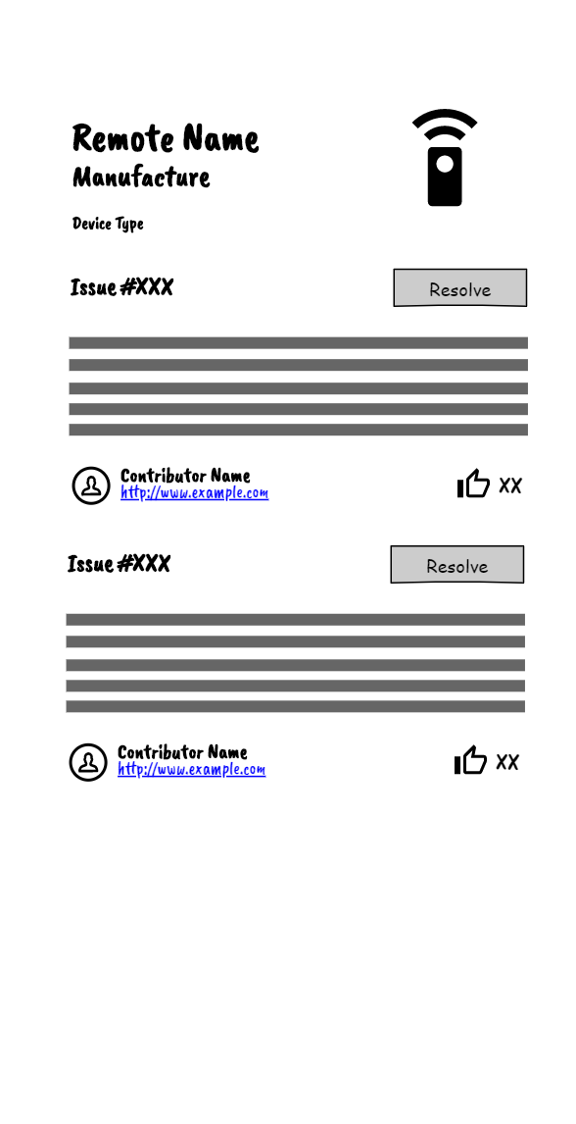
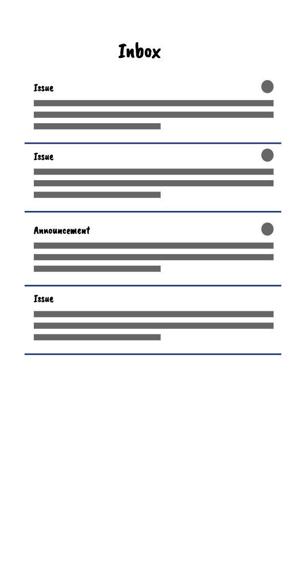
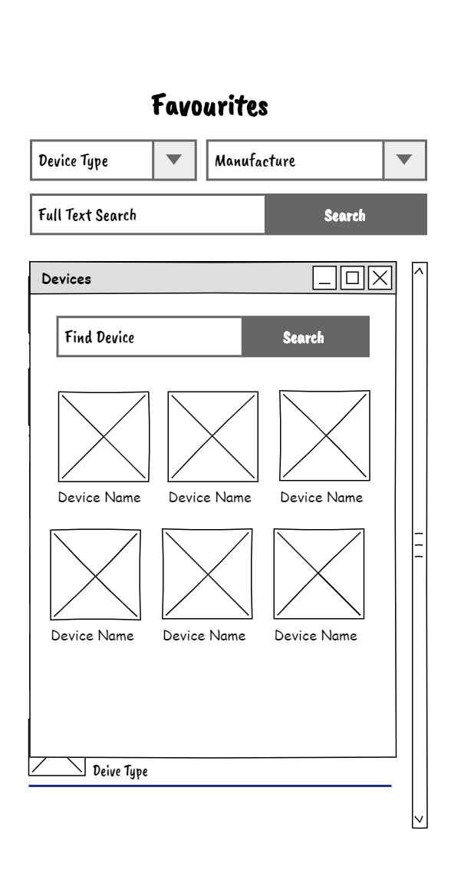
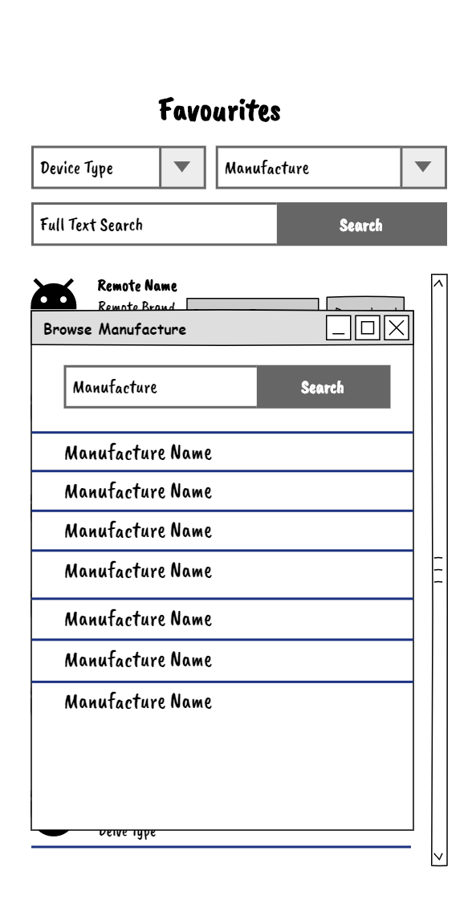
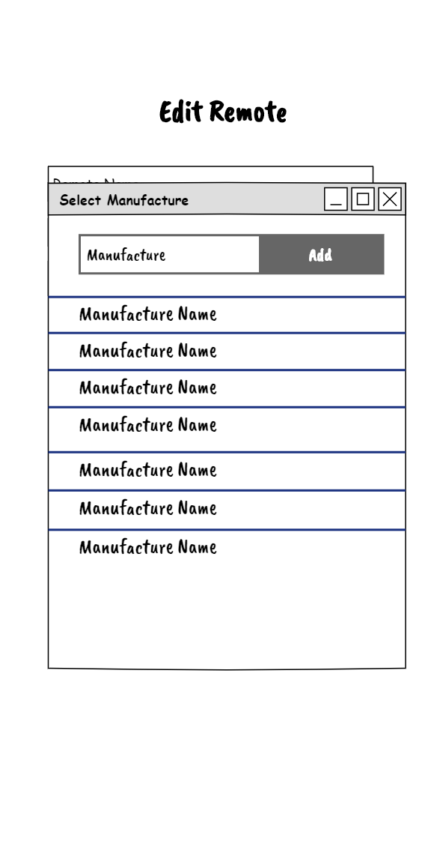
<slide-name>
Inframote by DCC Project Group 6
Slide <number> of 26

Slide 20
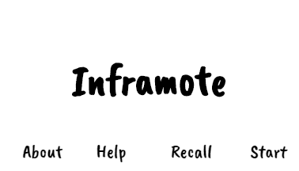
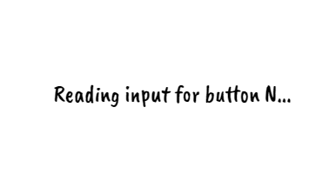
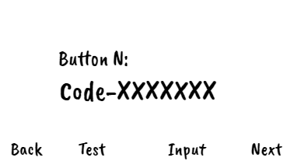

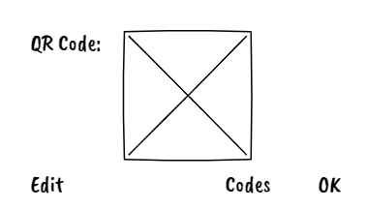
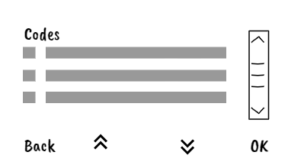
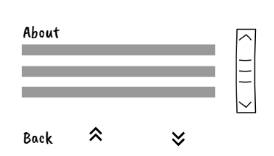

<slide-name>
Inframote by DCC Project Group 6
Slide <number> of 26

Slide 21








<slide-name>
Project Management & Documentation
Jira
Libre Office
Draw.io
Wire-framing & Design
DevOps
Pencil Project
Figma
Github
Bitbucket
Jira
Docker
Inframote by DCC Project Group 6
Slide <number> of 26

Slide 22










<slide-name>
Development Tools
Golang
Cloud SDK
.Make & .sh
PostgreSQL
Vim
Git
Docker
Testing Tool
Documentation Tool
Nightingle
Postman
Go Unit Test
OpenAPI
Swagger
Godoc
Inframote by DCC Project Group 6
Slide <number> of 26

Slide 23








<slide-name>
Decoder Device
Prototype Development
Android Development
Android Studio
Kotlin
C
Platform.IO
Firebase SDK
SQLite
EasyEDA
Fritzing
Inframote by DCC Project Group 6
Slide <number> of 26

Slide 24



<slide-name>
Hosting Providers
Marketplace
Google Cloud Run
Azure PostgreSQL
Google Playstore
Firebase
Inframote by DCC Project Group 6
Slide <number> of 26

Slide 25
<slide-name>
Inframote by DCC Project Group 6
Slide <number> of 26

Slide 26
THANK YOU

